Slide 1

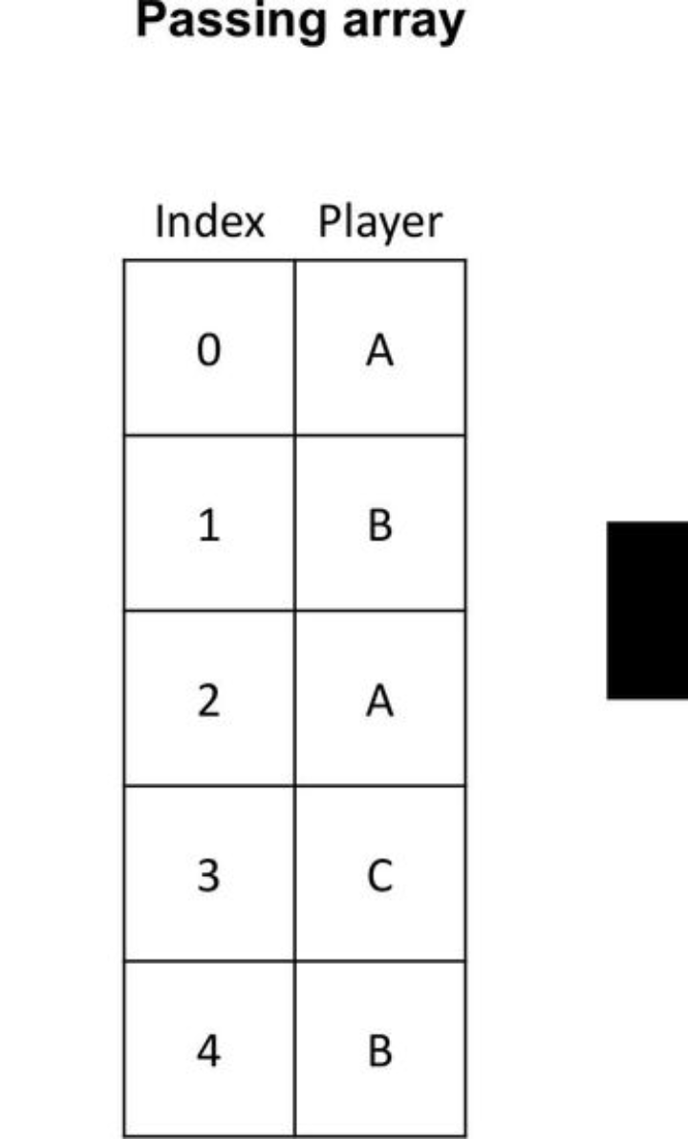
Introduction to passing arrays to functions in C
In C programming, passing arrays to functions is a fundamental concept. It allows the function to access and manipulate the elements of the array. Understanding how to pass arrays to functions is crucial for writing efficient and organized code. This process involves passing the array's memory address to the function, enabling the function to work directly with the original array. Let's delve into the syntax and mechanisms for passing arrays to functions in C.

Slide 2
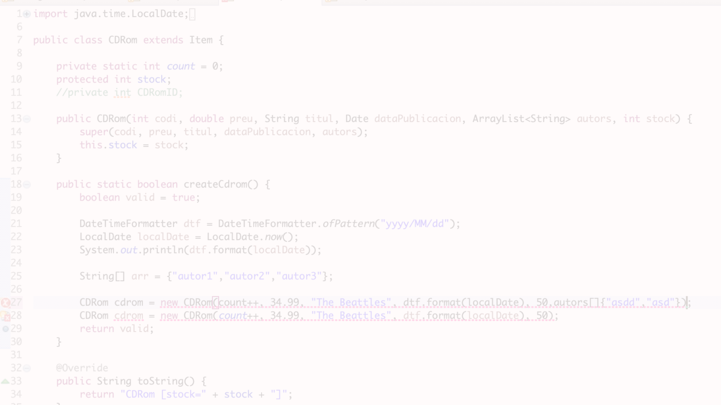
Syntax for passing arrays to functions
Array Declaration
Function Definition
Calling the Function
In C, arrays are declared with a defined size and type. The syntax to declare an array and pass it to a function involves specifying the type of the elements and the size of the array within the function parameter list.
When passing an array to a function, the function definition includes the array type label followed by square brackets to indicate that the function accepts an array argument.
When calling a function that receives an array as an argument, the array name is passed inside the function call, and the function works directly with the original array.

Slide 3
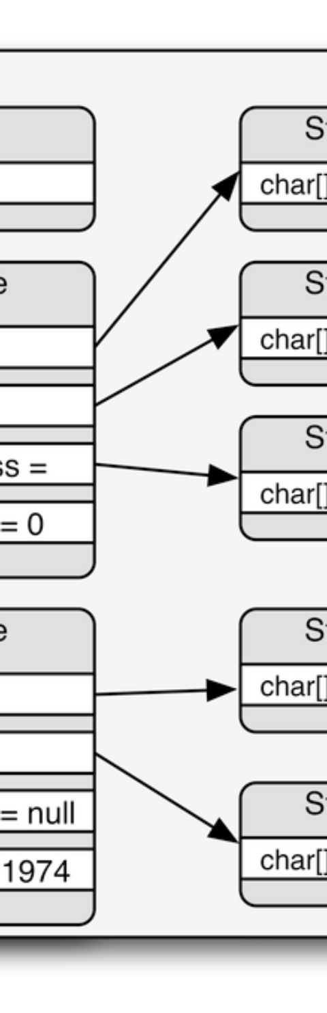
Passing arrays by value
1
Creating a Copy
When an array is passed by value, a copy of the entire array is made and passed to the function. This allows the function to manipulate the array without affecting the original.
2
Memory Overhead
Passing arrays by value introduces a memory overhead, as the entire array needs to be duplicated. This can be inefficient for large arrays.
3
Changes are Isolated
Any changes made to the array within the function are isolated and do not affect the original array in the calling function.

Slide 4
Passing arrays by reference
Direct Access
Efficiency
Impact on Original Array
When an array is passed by reference, the function receives a pointer to the original array. This allows the function to directly access and manipulate the original elements.
Passing arrays by reference is generally more efficient as it avoids creating a copy of the array. This is beneficial for working with large arrays.
Modifying the array within the function directly impacts the original array, as they both share the same memory location.

Slide 5
Benefits of passing arrays to functions
1
Code Reusability
2
Modularity
Passing arrays to functions promotes code reusability by allowing the same function to operate on different arrays in different parts of the program.
It enhances the modularity of the code by separating array processing into distinct, reusable functions, making the code more organized and maintainable.
3
Memory Efficiency
4
Improved Readability
By passing arrays as pointers, the memory overhead associated with copying large arrays is minimized, leading to more memory-efficient programs.
Passing arrays to functions can enhance code readability, as the logic for working with arrays is encapsulated within dedicated functions.

Slide 6
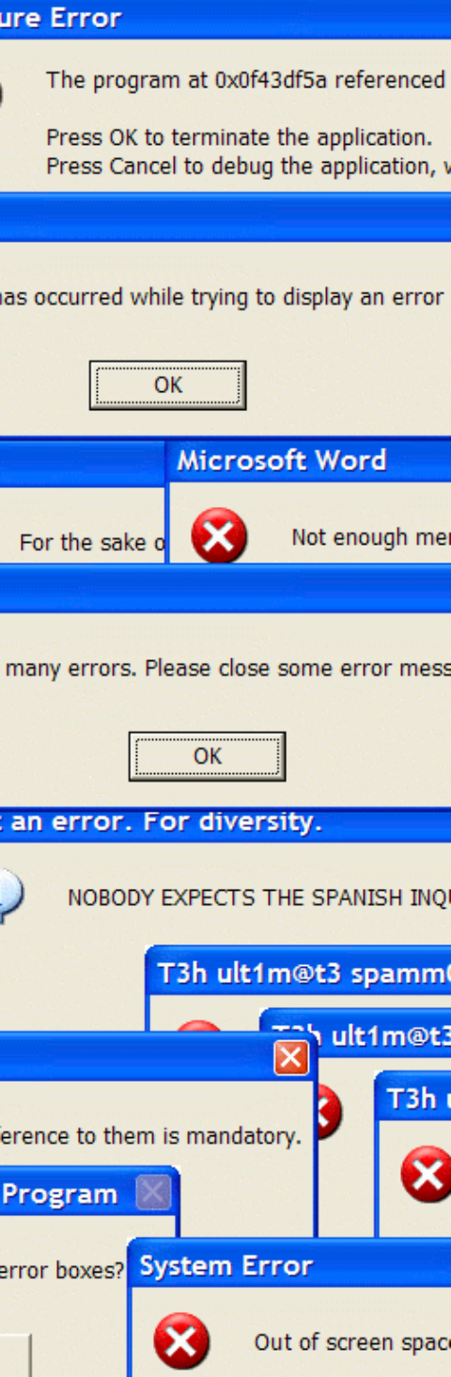

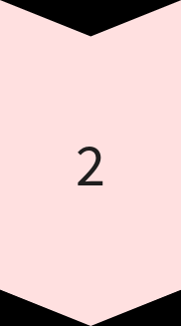
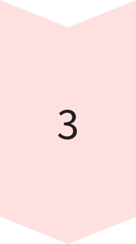
Common mistakes passing arrays to functions
Confusion with Array Size
One common mistake is failing to pass the size of the array alongside the array itself, leading to errors in processing and memory access.
Incorrect Array Type
Using an incorrect array type in the function parameter can lead to unexpected behavior and erroneous results during array processing.
Undefined Behavior
Failing to handle edge cases and boundary conditions when passing arrays to functions can lead to undefined behavior and runtime errors.

Slide 7
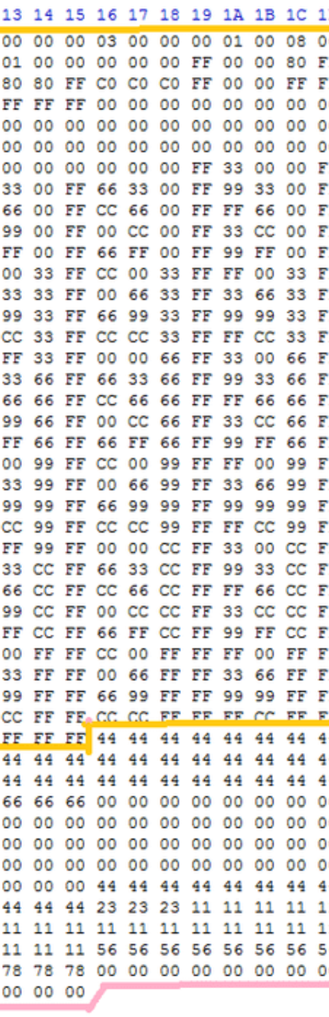
Examples of passing arrays to functions
1
Summing Elements
An example illustrating the function to calculate the sum of elements in an array passed as an argument and returning the result.
2
Sorting an Array
Demonstrating a function that takes an array and rearranges its elements to be in ascending or descending order.
3
Searching an Array
An example showing a function that searches for a specific element within an array and returns its index.

Slide 8
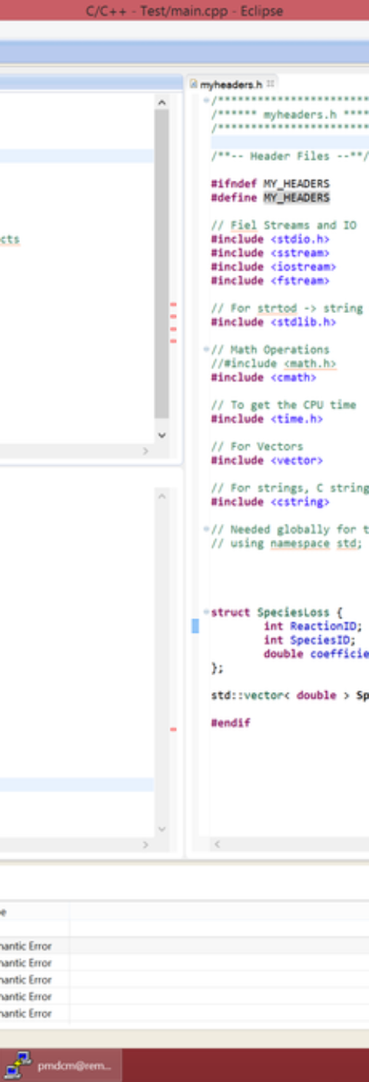
Conclusion and key
Flexibility
Efficiency
Passing arrays to functions enhances the flexibility and usability of C programs, allowing for modular and organized code development.
Understanding the different methods of passing arrays to functions enables programmers to write efficient and optimized code that conserves memory and processing resources.
Best Practices
Awareness of common mistakes, along with best practices for passing arrays to functions, is crucial for maintaining code stability and reliability.

